Slide 1

HOCKEY IS BACK!!!!

Slide 2

Thought Process
Predicting whether the home team will win or not in an NHL game
Predict the Home Team to win every time!
Predicting whether an NHL game will be a high scoring game

Slide 3
Motivation and Goal
Will an NHL game be an exciting, high scoring game?
High scoring: greater than 7 total points
NHL Recent Rule Changes
Higher scoring games

Slide 4



Methodology
2018-2019 NHL Schedule Results Data
Classification Models

Slide 5
Results
Features:
Last Ten Games
Away Team - Goals Scored (Highest Importance)
Home Team - Goals Scored (Lowest Importance)
Home Team - Total Points
Away Team - Total Points

Slide 6
Results
Features:
Last Ten Games
Away Team - Goals Scored (Highest Importance)
Home Team - Goals Scored (Lowest Importance)
Home Team - Total Points
Away Team - Total Points
F1: 0.2857
Precision: 0.36
Recall: 0.23

Slide 7


NY Rangers vs. NJ Devils (Mar. 9, 2019)
4
2

Slide 8

NY Rangers vs. NJ Devils (Mar. 9, 2019)

Slide 9
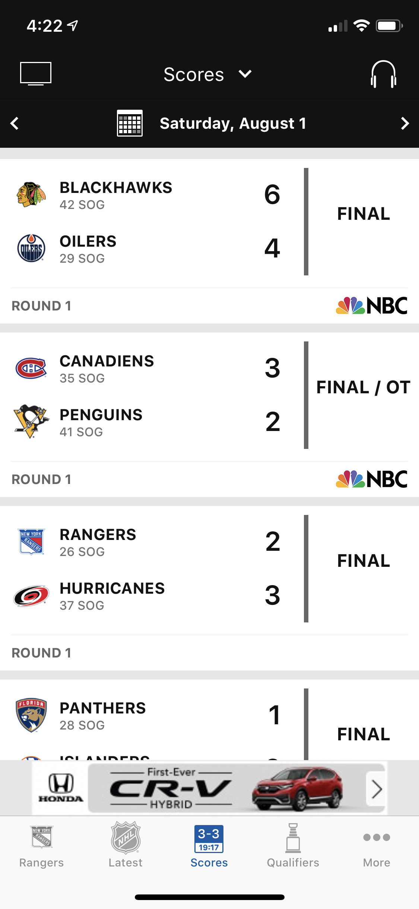
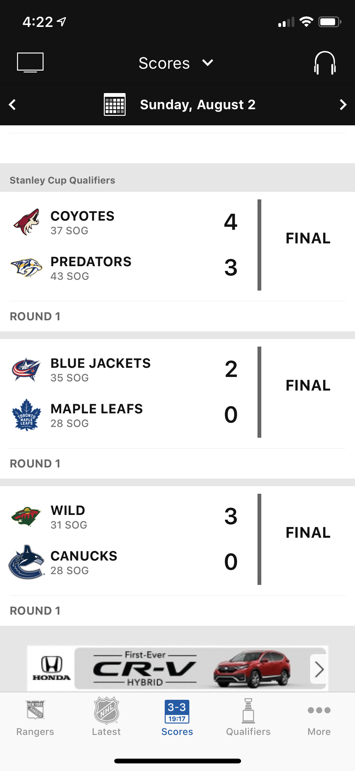
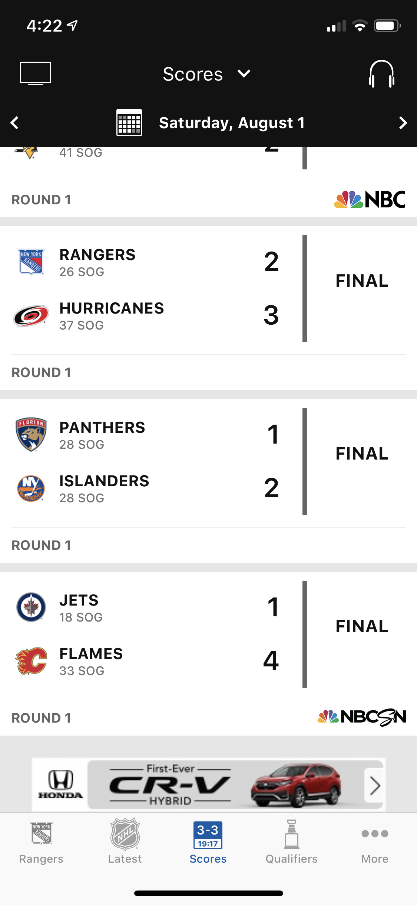
NHL Pre-Playoffs 2020

Slide 10
NHL Pre-Playoffs 2020

Slide 11
Conclusion
Sports outcomes are hard to predict
Humans are unpredictable
More factors go into the game results

Slide 12
QUESTIONS??

Slide 13
Future Work
More Data – Both Models
Hockey Fights – Fans Love Fights

Slide 14
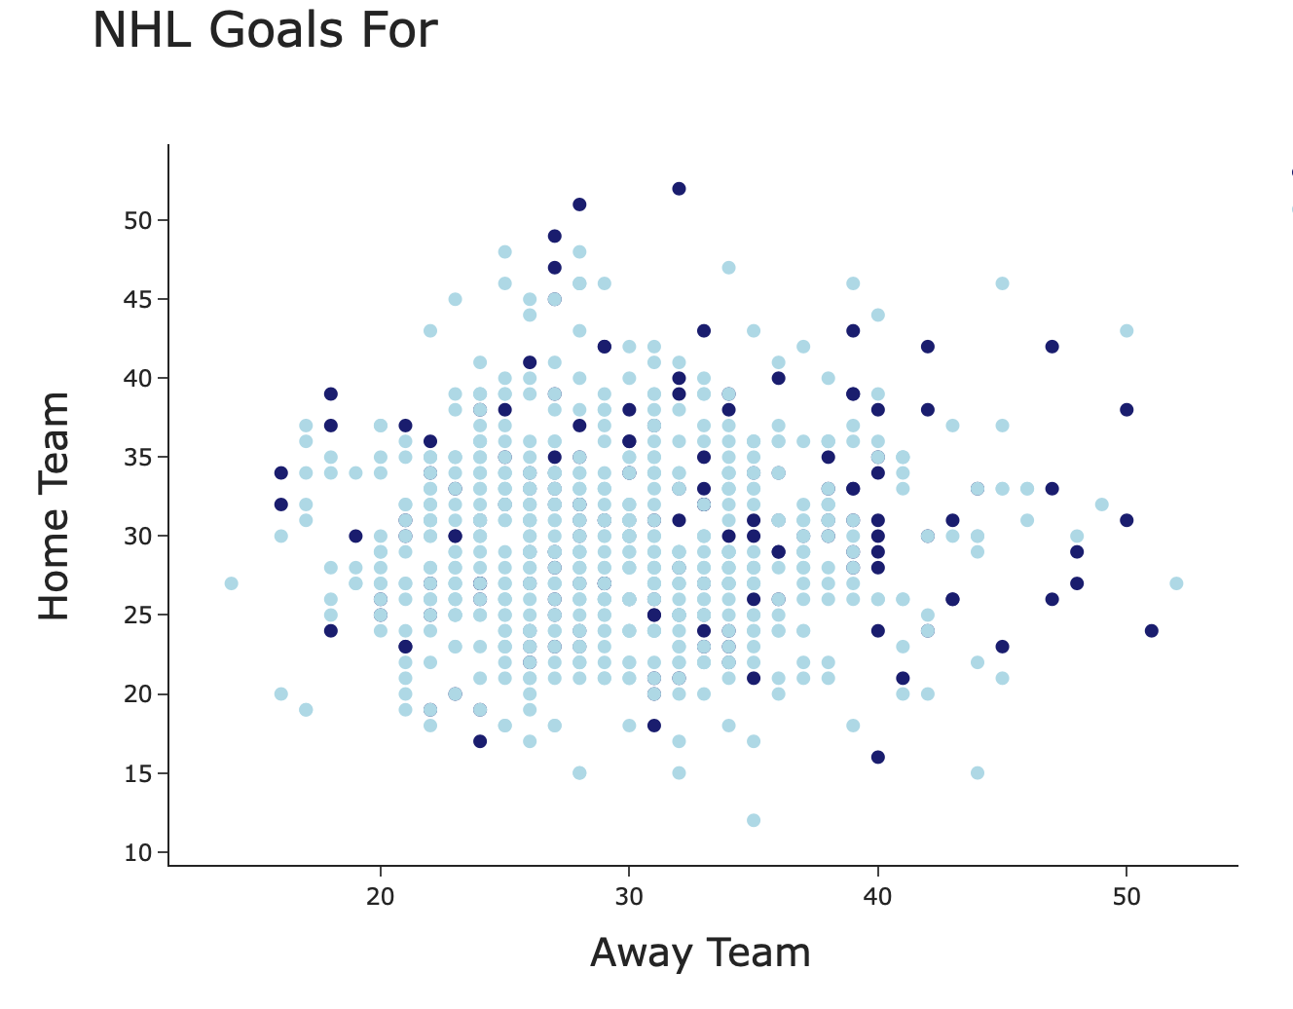
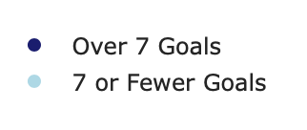
Last Ten Games Goals

Slide 15
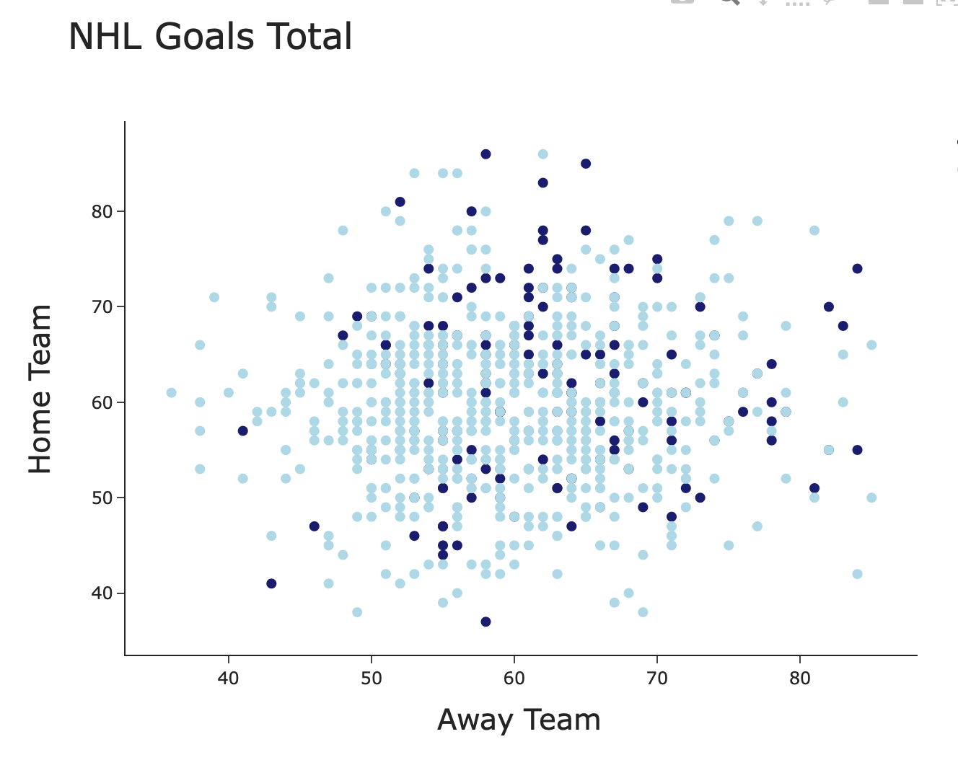
Last Ten Games Points

